Slide 1

Developing an Anime Recommendation System
By Denise Tanumihardja

Slide 2
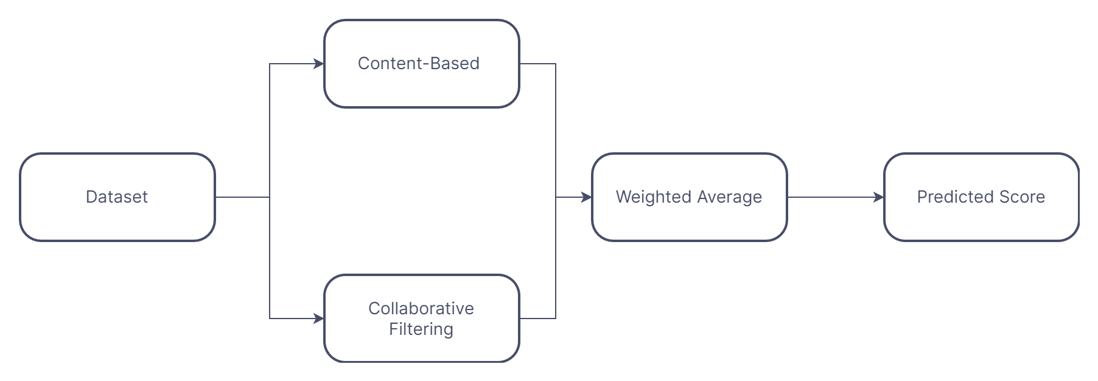
Goal and Motivations
Creating a hybrid recommender system to recommend anime shows.
Recommending lesser-known shows to new fans.

Slide 3
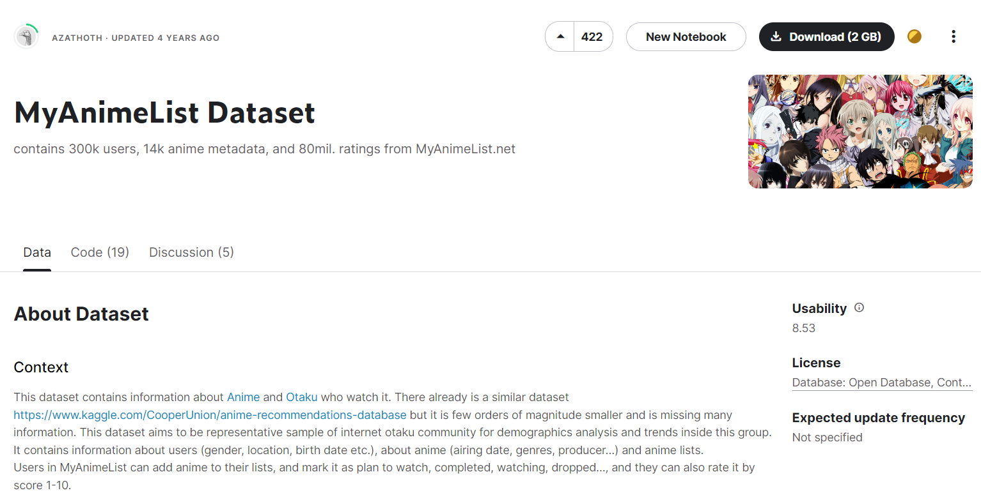
Dataset and Methodology
Using a Kaggle dataset of anime shows mined from an anime review and rating site called MyAnimeList.

Slide 4
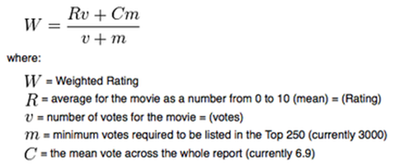
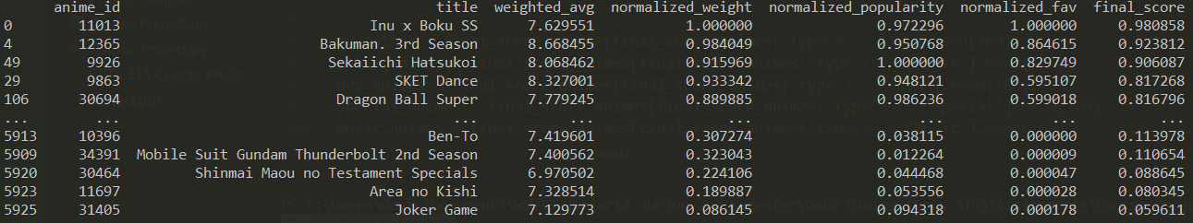
Dataset and Methodology
Weighted hybrid collaborative-filtering recommendation system.
Calculating final scores using 33% priority of normalized values.

Slide 5
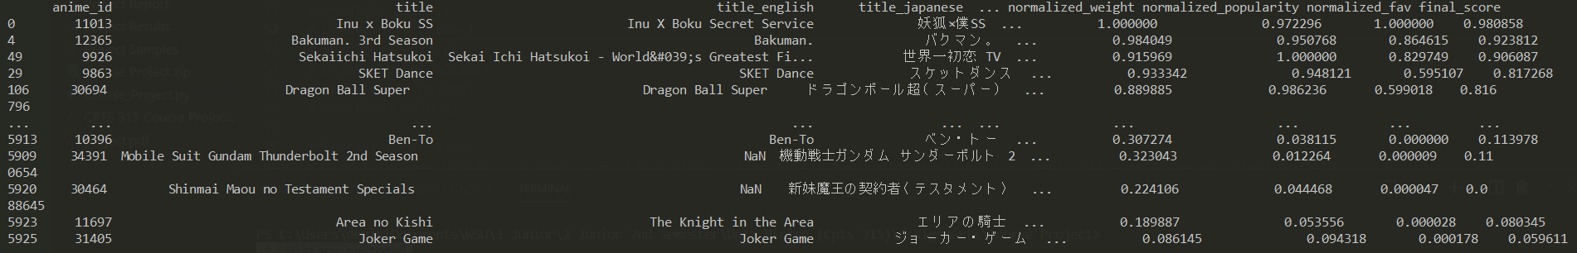
Results
Recommending animes in order of most recommended/highest final score.
Recommended based on type/category.

